Slide 1



UPPER DARBY
SCHOOL DISTRICT
Facilities Updates – Summer Projects
September 22, 2020
Opportunity · Unity · Excellence

Slide 2

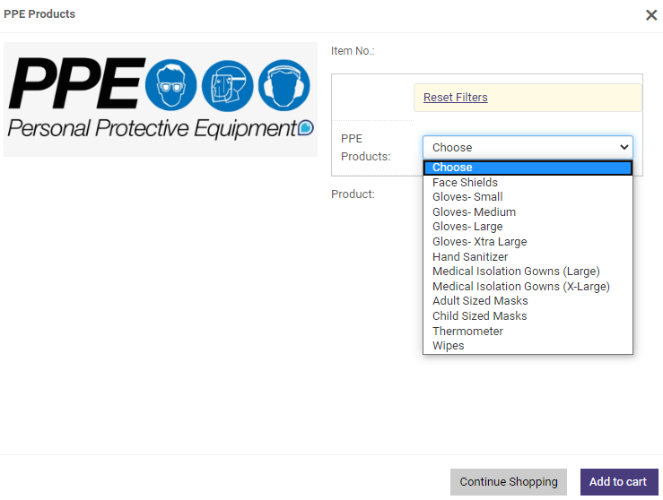
Personal Protective Equipment
1 | COVID-19 Preparedness
2 | Completed Projects
3 | On-Going Projects
Disinfecting Wipes
Electrostatic Sprayers
Face Masks
Face Shields
Gloves (Non-Latex / Non-Powder)
Hand-Held Thermometers
Hand Sanitizers
Plexiglass Barriers
Plexiglass Sneeze Guards
Standalone Thermometer
Core PPE in Possession
PPE Ordering through Existing Print Shop Portal
Opportunity · Unity · Excellence

Slide 3
Posters and Signages
1 | COVID-19 Preparedness
2 | Completed Projects
3 | On-Going Projects
Various Posters, Signages, and Floor Stickers were provided to each school
Opportunity · Unity · Excellence

Slide 4
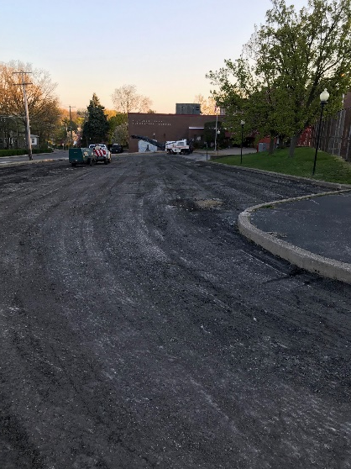
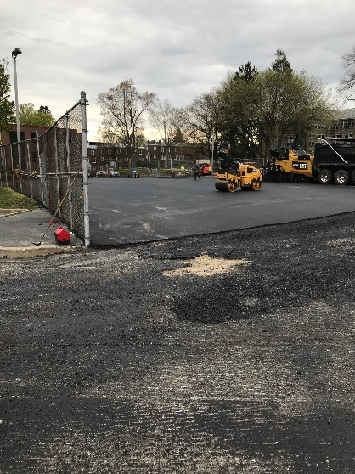
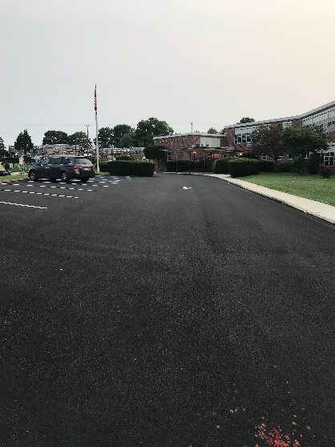
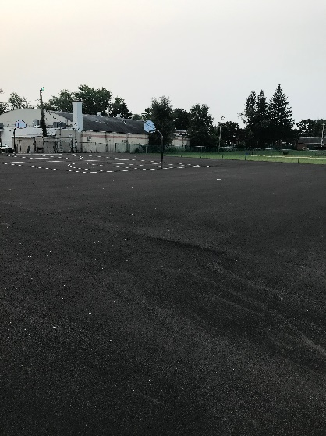
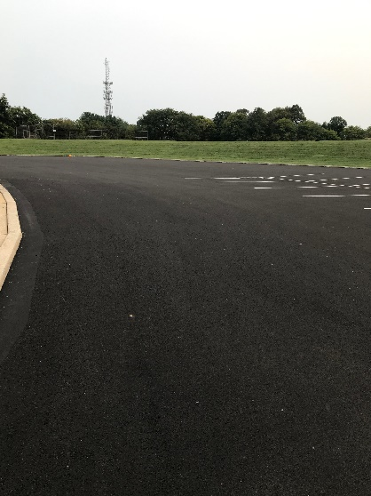
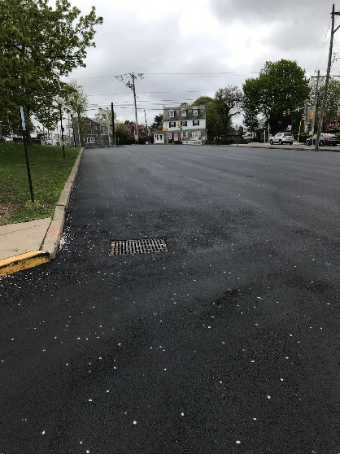
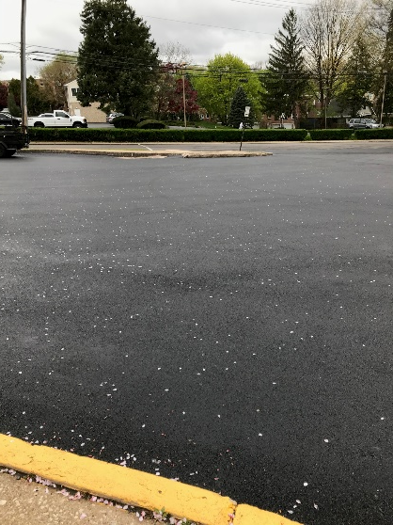
Blacktop Repaving / Restriping
Summer 2020: Repaving / Striping
 | # Areas | Sq. Yds
Bywood | 5 | 5,716
Hillcrest | 2 | 1,160
Highland Park | 3 | 8,345
Primos | 3 | 6,556
Westbrook Park | 6 | 8,489
Drexel Hill | 1 | 4,725
High School | 2 | 7,107
 | 22 | 42,098
1 | COVID-19 Preparedness
2 | Completed Projects
3 | On-Going Projects
← During Construction at Highland Park
Note: Bywood: 1 area was seal coated.
Highland Park
Highland Park
Westbrook Park
Westbrook Park
Primos
Opportunity · Unity · Excellence

Slide 5
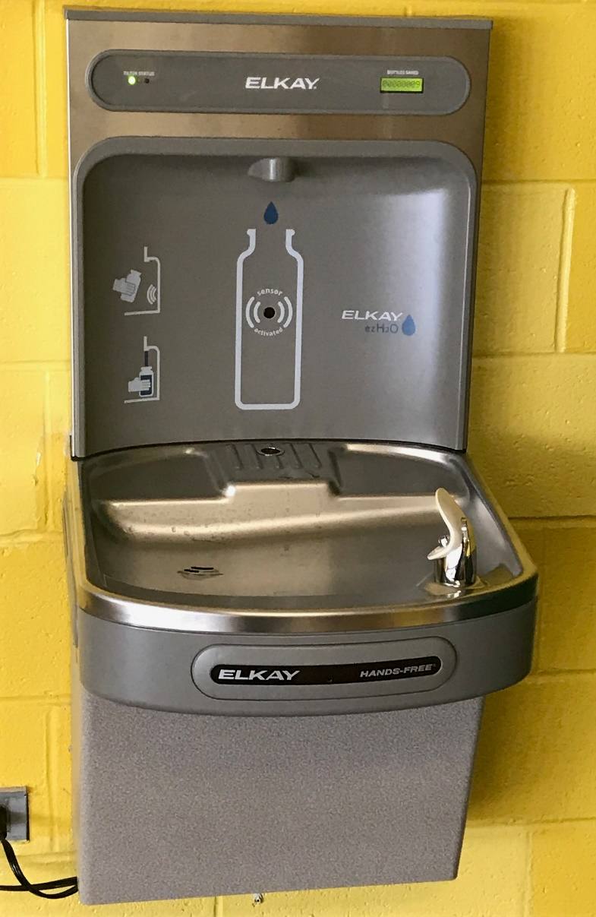
Touchless Bottle-fill Water Fountains
1 | COVID-19 Preparedness
2 | Completed Projects
3 | On-Going Projects
Touchless Bottle-Fill Water Fountains
At least 1 unit on each floor of our schools
Total 45 Units will be installed before the students come back to school
Opportunity · Unity · Excellence

Slide 6
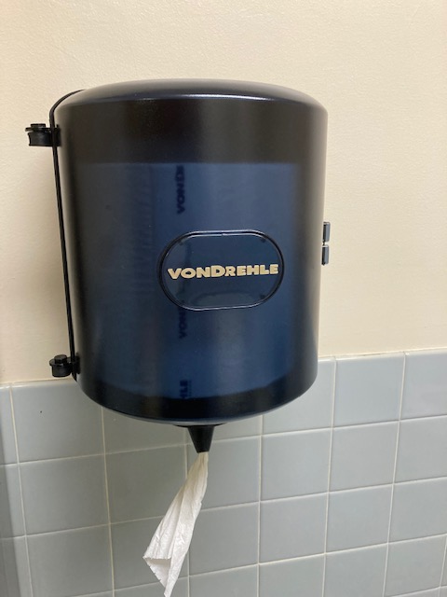
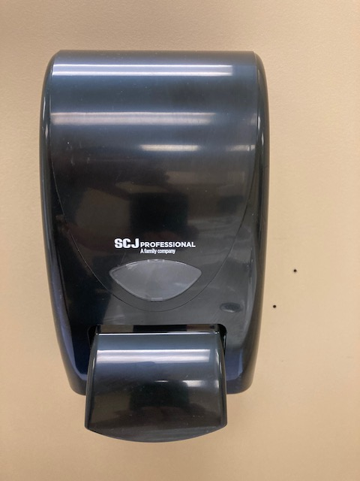
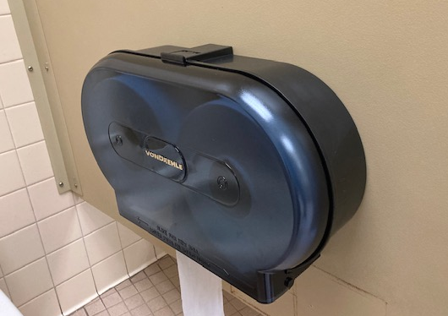
New Dispensers
1 | COVID-19 Preparedness
2 | Completed Projects
3 | On-Going Projects
Model Selection: Through Product Demonstration (Admin., Custodians, Cleaning Company)
Target Dispensers: Toilet Paper / Hand Soap / Hand Towel
Total Units: More than 2,000 units were replaced
Other Benefits: Standardization of Cleaning Chemical / Custodial Supplies
On-Line Ordering (Catalog is controlled by Admin.)
Just –In-Time Delivery (Usually 24 Hour Delivery Turnaround)
Opportunity · Unity · Excellence

Slide 7
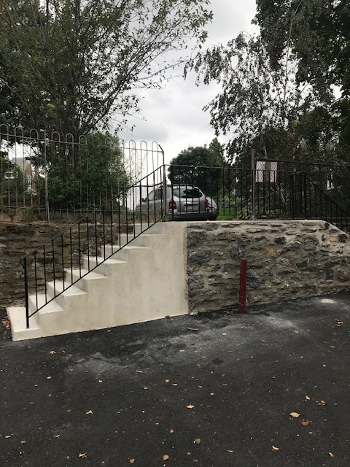
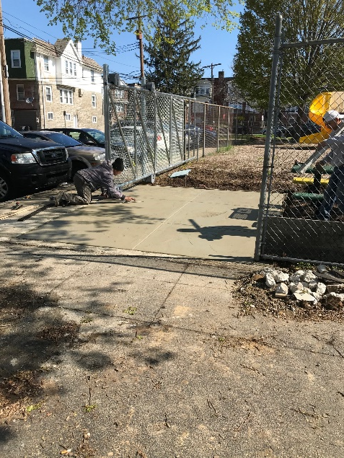
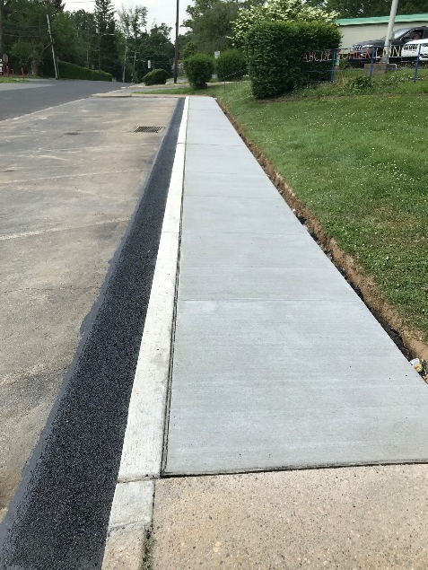
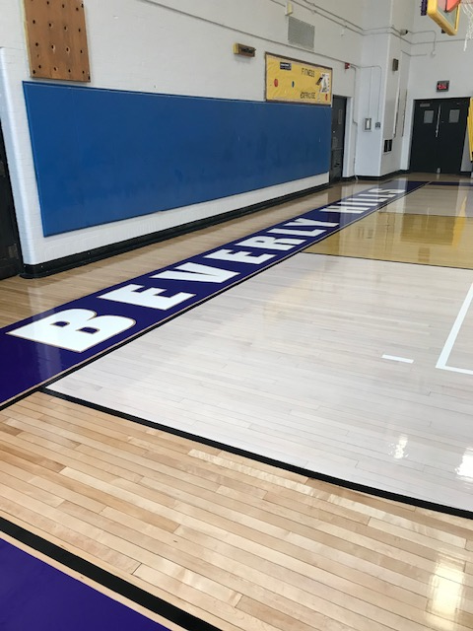
Other Projects
1 | COVID-19 Preparedness
2 | Completed Projects
3 | On-Going Projects
New Stairs @
Highland Park
New Meet and Greet Location @ Bywood
Sidewalk Repair @
Beverly Hills, Bywood, K-Center, Primos, and High School
New Gym Floor @ K-Center, Beverly Hills and Drexel Hill
Also addressed:
Lower Roof Replacement @ Garrettford, Hallway Paint @ Primos, Tile Work @ Various Schools, New PA System @ Highland Park, and Many Others
Opportunity · Unity · Excellence

Slide 8
Windows @ Beverly Hills / Garrettford
1 | COVID-19 Preparedness
2 | Completed Projects
3 | On-Going Projects
Beverly Hills Window Replacement
Brief Scope:
Replacement of window sashes and balances with exterior panning for the remaining window not replaced under Phase 1 of the window project
Originally Agreed Start Date: 5/18/2020
Adjusted On-Site Mobilization:
Estimated Construction Duration: 10–12 weeks
Garrettford Window Replacement
Brief Scope:
Complete replacement of window sashes frames and balances throughout the building
Originally Agreed Start Date: 5/18/2020
Adjusted On-Site Mobilization:
Estimated Construction Duration: 8–10 weeks
Reason for Delay:
COVID-19 has severely impacted window manufacturing. Plants are reducing staff to avoid spread while maintaining social distancing protocols. These precautions are dramatically increasing production durations for new windows.
Opportunity · Unity · Excellence

Slide 9
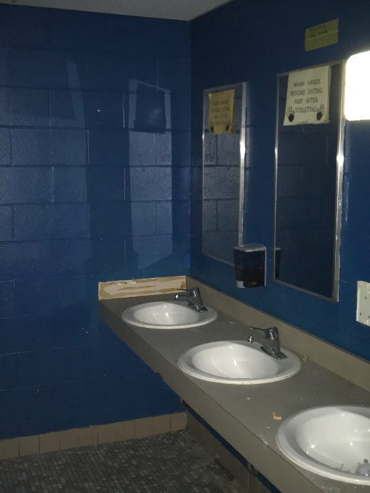
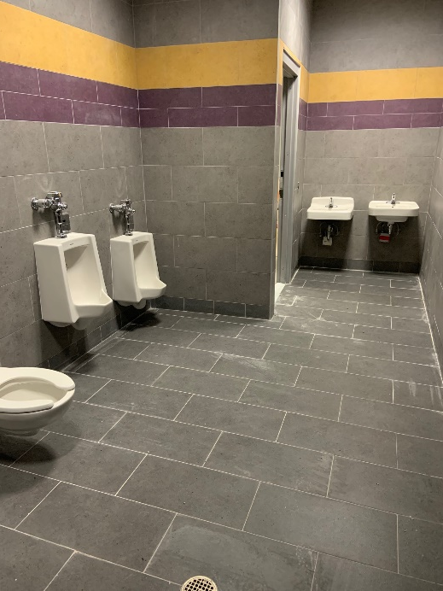
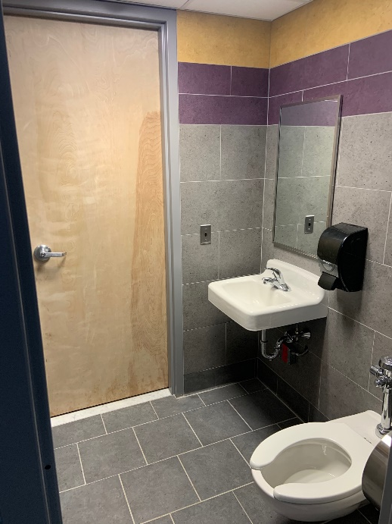
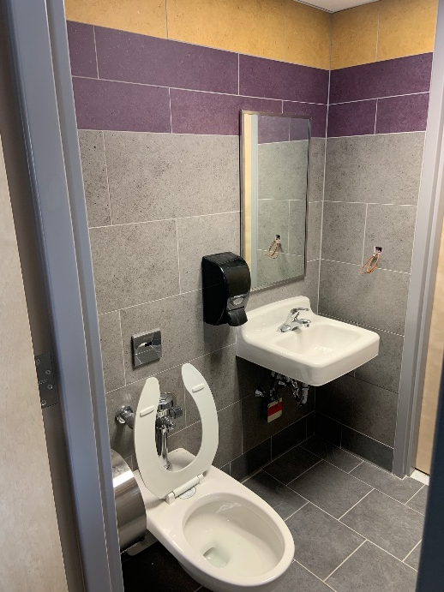
Toilet Rooms @ Drexel Hill / Stonehurst
1 | COVID-19 Preparedness
2 | Completed Projects
3 | On-Going Projects
Brief Scope of Construction
Removal and replacement of all toileting fixtures and drinking fountains throughout the building (excluding gym locker room at Drexel Hill).
Fixture Counts | Lavatory | Toilet | Stalls | Urinal | Drinking Fountain
Drexel Hill | 46 | 52 | 51 | 20 | 20
Stonehurst | 23 | 28 | 21 | 7 | 14
Total | 69 | 80 | 72 | 27 | 34
Before Modernization @
Stonehurst
Toilet Room Modernization Work-In-Progress @ Stonehurst
Opportunity · Unity · Excellence

Slide 10
Questions?

